Slide 1
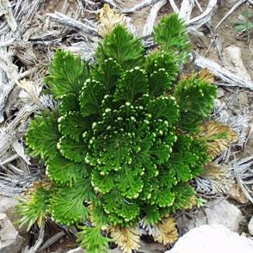
Plant of the Day
Selaginella lepidophylla (aka Resurrection plant, false rose of Jericho)
Species of desert plant in the spikemoss family (lycophytes evolved 400 million years ago and lack true leaves and roots)
Sold as a novelty plant
Selaginella moellendorffii genome sequenced (smallest plant genome yet 127Mbp)
Used to identify genes for drought tolerance for use in crops
Notes:
‹#›

Slide 2
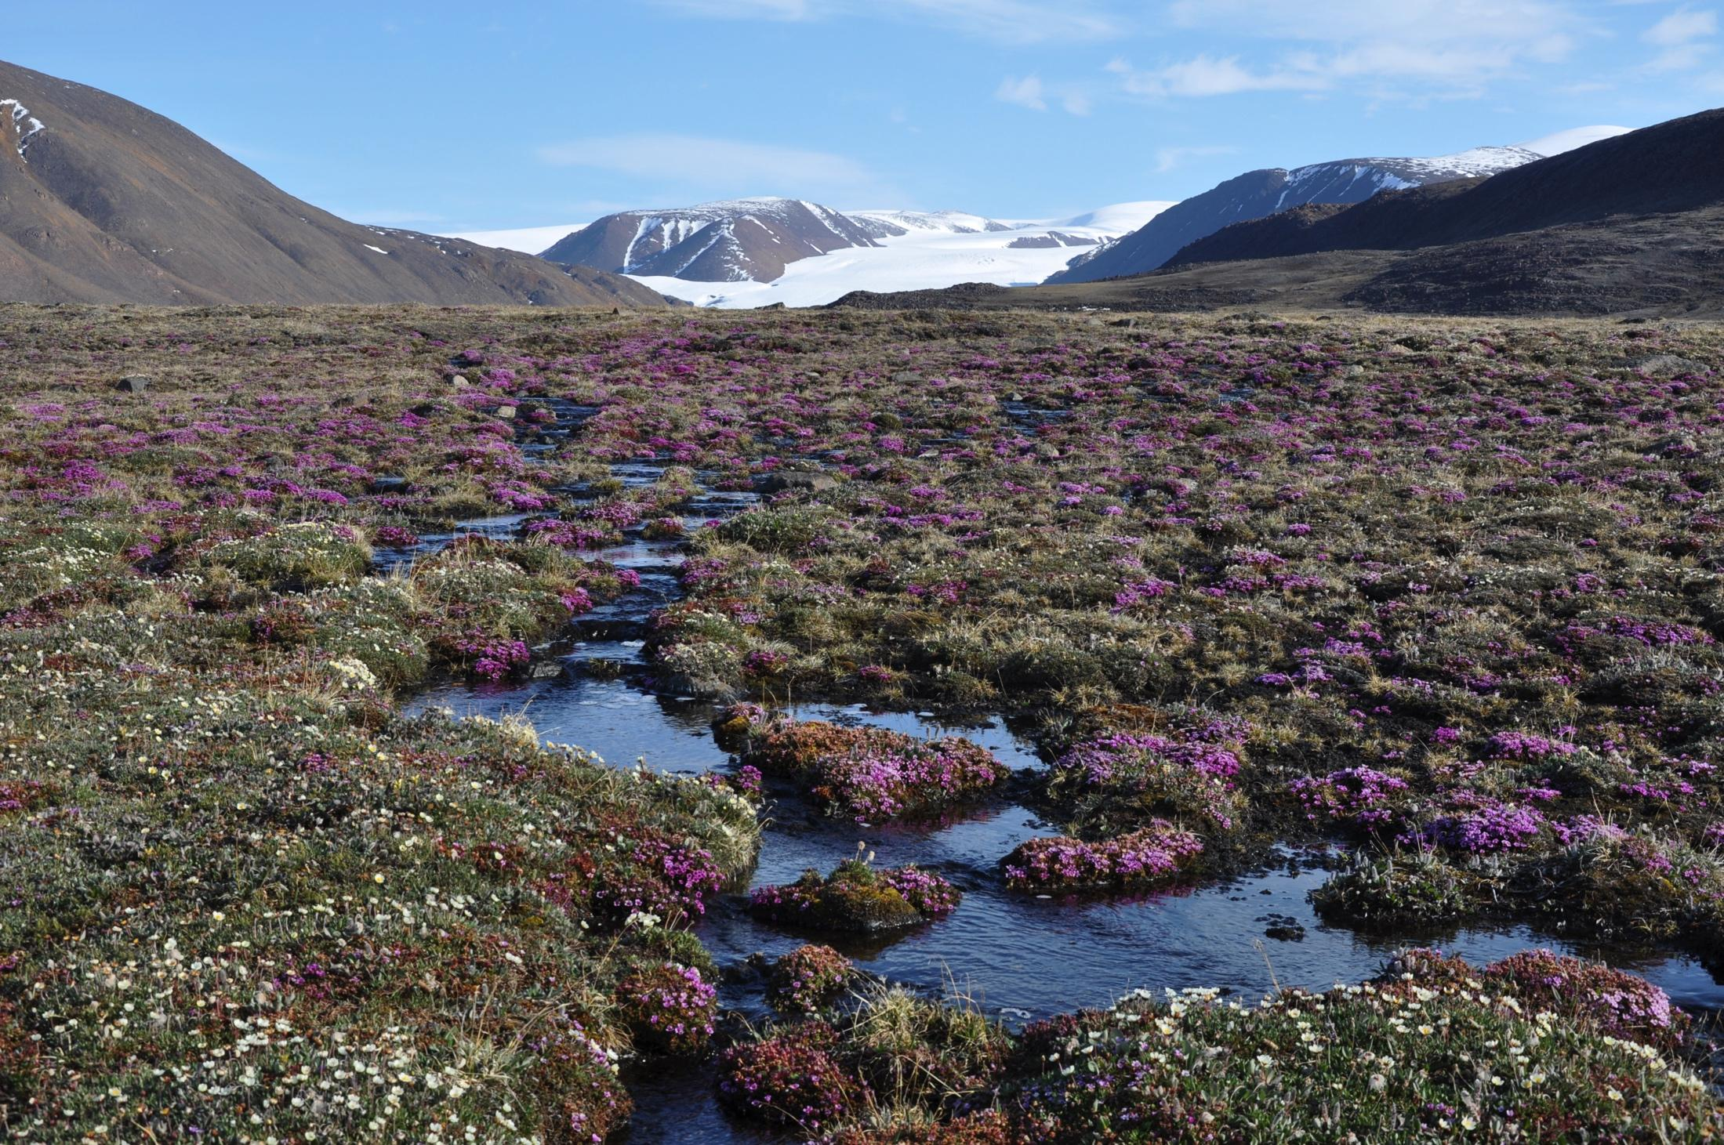
Plant Evolution and Climate change – Biq Questions
The global selection experiment
How will species, populations and communities respond to climate change?
Can plants adapt or migrate fast enough to avoid extinction?
How can we minimize extinction due to climate change?
Notes:
‹#›

Slide 3
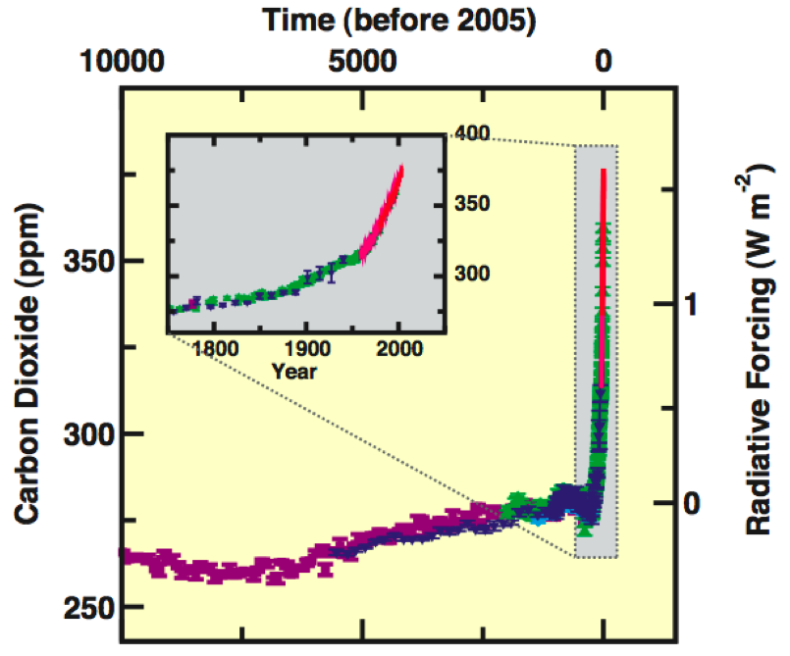
CO₂
“The global atmospheric concentration of carbon dioxide has increased from a pre-industrial value of about 280 ppm to 379 ppm in 2005.” - IPCC Report, 2007
Methane and nitrous oxide show similar trends
Radiative forcing = the difference between the incoming radiation energy and the outgoing radiation energy in a given climate system

Slide 4
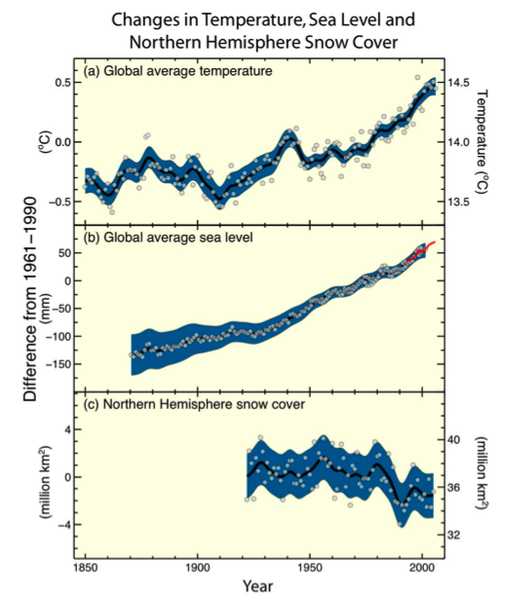
Wide-ranging effects of increased CO₂
Climatic changes
Increase in plant growth rates
Temperature increases
Changes in seasonality
Changes in precipitation
Changes in growing season
Extreme climatic events

Slide 5
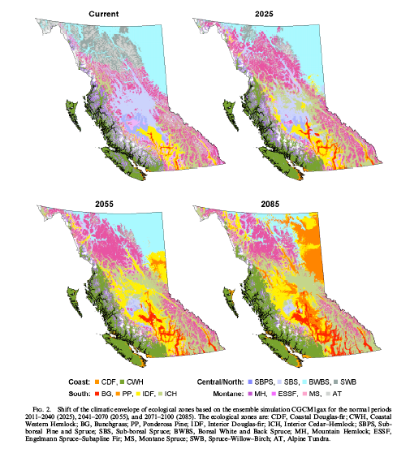
Predicted changes in the bioclimatic envelopes of BC

Slide 6
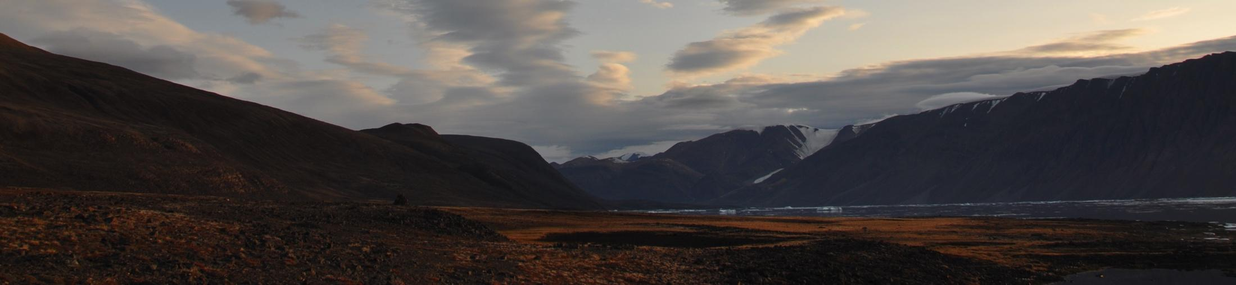
How will species, populations and communities respond to climate change?
Migration (of individuals or through seed dispersal)
Phenotypic plasticity (individual variability)
Evolutionary adaptation
4) Extinction

Slide 7
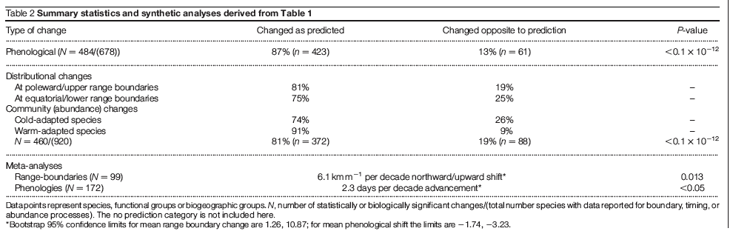
How are species, populations and communities responding to climate change?
Parmesan and Yohe Nature 2003

Slide 8
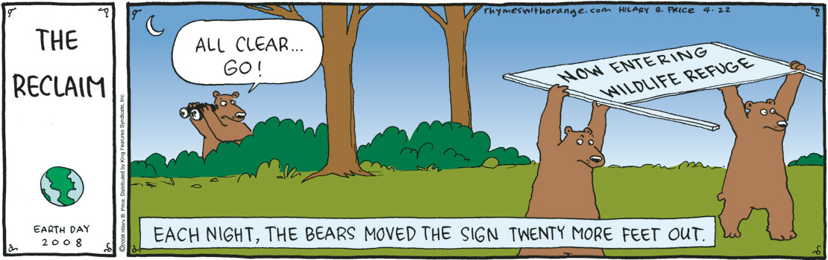
Migration

Slide 9
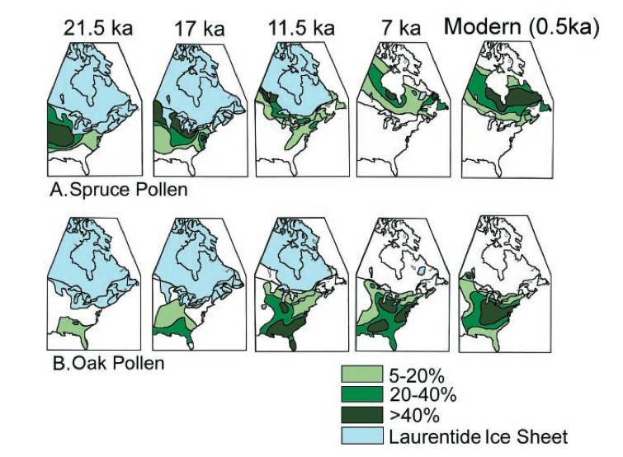
How quickly have trees moved in the past? Pollen records suggested up to 200 m/year
Check out: http://www.ncdc.noaa.gov/paleo/pollen/viewer/webviewer.html
Davis & Shaw, Science 2001

Slide 10
Are estimated migration rates fast enough?
To track climatic changes in the future, range limits would need to move northward 100 km per °C warming, or about 300 km per century, an order of magnitude faster than range extension occurred in the past.
Upshot: warming may be too fast for many tree species to track northward shift of their climatic envelope
What type of species will be able to track changes in climate?
Davis, Climatic Change 1989

Slide 11
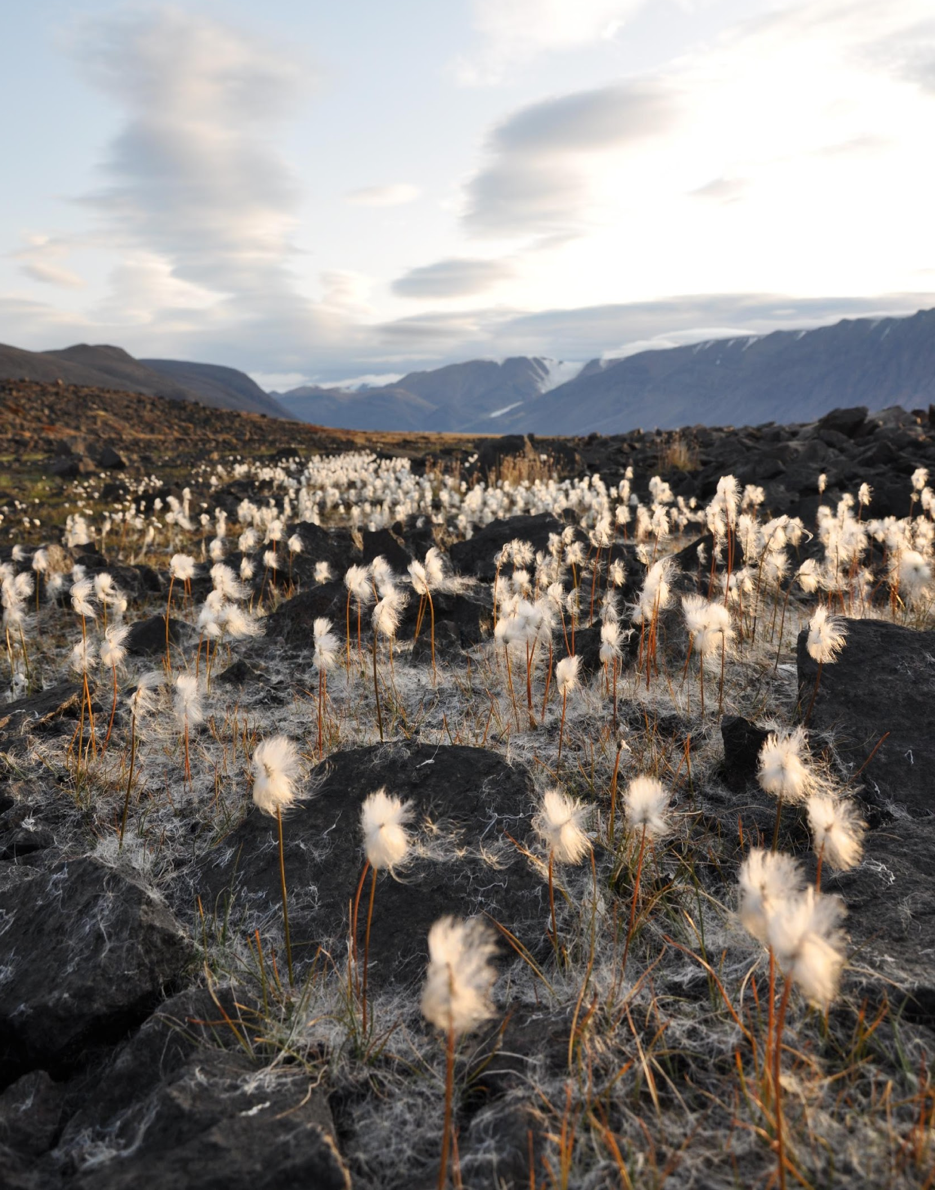
What limits the speed of migration?
Seed dispersal
Pollen movement
Biotic constraints
Habitat fragmentation
Geographical barriers
Notes:
Disequilibrium between species – i.e. between butterfly and host plant or between predator and prey
‹#›

Slide 12
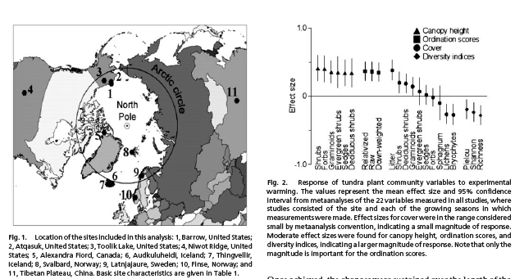
Phenotypic Plasticity
Walker et al., PNAS 2006
Rapid response to climate warming
2 growing seasons at 1-3 degree increase
Vascular plants will grow taller and become more massive
Some species will increase in frequency (e.g. deciduous shrubs)
Others (e.g. lichens) will decline, leading to a decrease in diversity

Slide 13
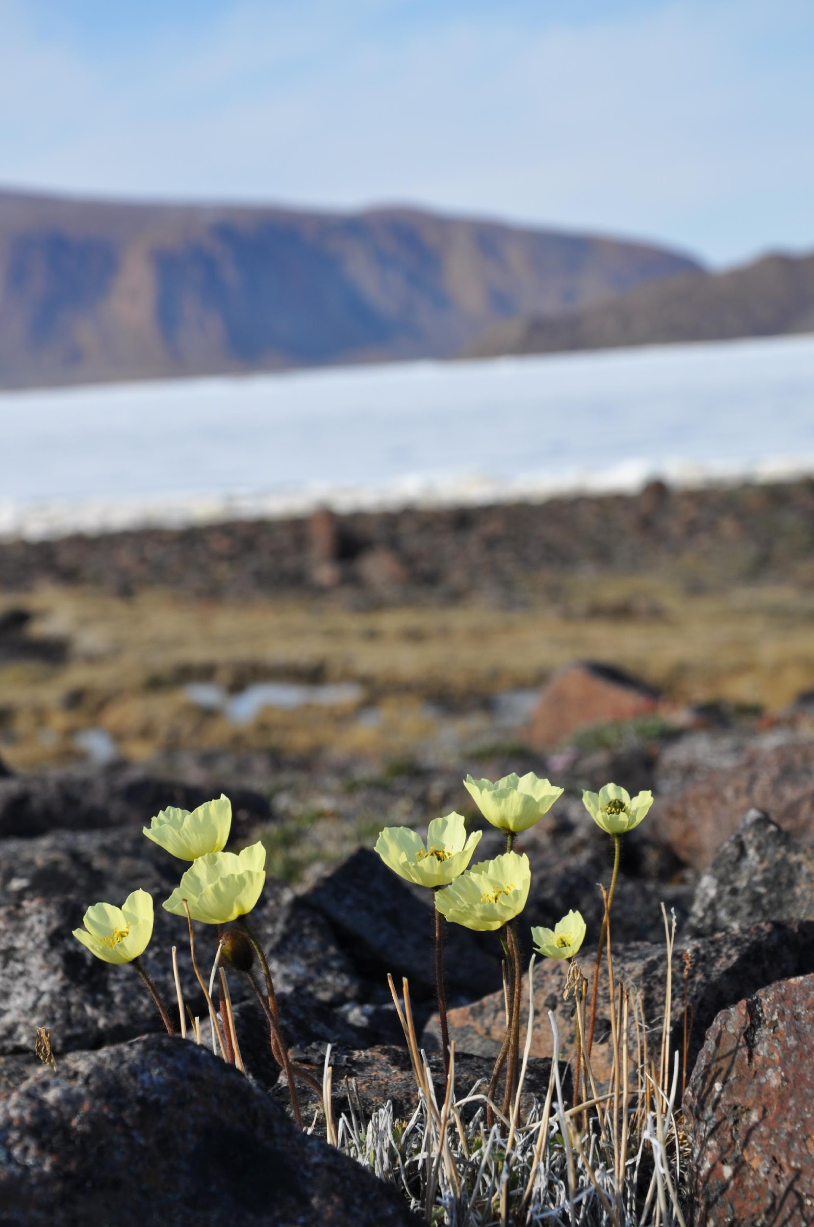
Limits to the extent of plasticity
A plant can only grow so tall or flower so early → constrained by genetics.
Plasticity can slow adaptive change
Why?
Plasticity is a trait that could be selected for
Selection for genotypes able to withstand increasingly variable environments
Notes:
‹#›

Slide 14
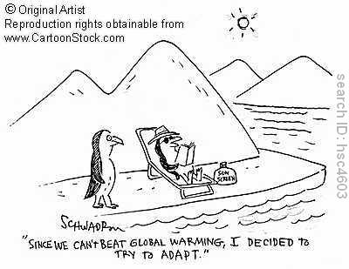
Adaptation

Slide 15
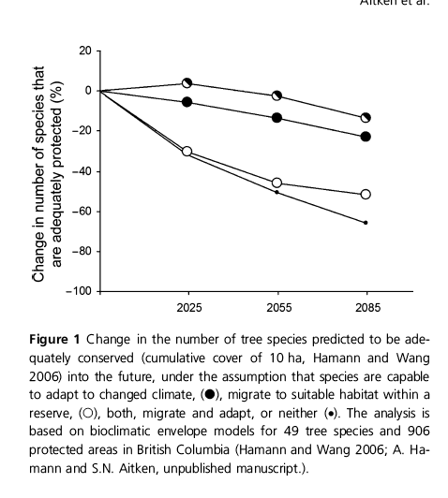
Adaptation
Adaptation has the potential to help reduce the effects of climate change on extinction
Aitken et al 2008

Slide 16
What is the Sustainable Rate of Adaptation?
Mean before
selection
Frequency
Large populations: “a few percent” of a phenotypic standard deviation per generation (Lynch, 1996).
Trait value
Mean next
generation
Frequency
Small populations: < 1% of a phenotypic standard deviation per generation (Burger and Lynch, 1995).
Response to selection

Slide 17


Why is it so slow?
Depletion of beneficial genetic variation
Cost of selection (Haldane, 1957)
The rate of adaptation is limited by the number of selective deaths that have to occur to replace one allele with another.
x
rr
x
Rr
x
rr
x
rr
x
Thermal Tolerance
rr
x
rr
rr
Time
– If selection is too strong, the population will go extinct.
– Density-dependent “soft” selection provides a buffer against extinction.

Slide 18
Factors that affect speed of adaptation
Large Populations: ⇑ beneficial mutations
Large Number of Genes : ⇑ beneficial mutations
High Rate of Recombination (in large populations)
Strong Selection: ⇑ initial rate of adaptation
Constant Selection
Speed of adaptation
Small Populations: ⇓ beneficial mutations, drift, inbreeding depression
Fluctuating selection
Low trait heritability
Gene flow: increases variability, but reduces efficiency of selection
Genetic correlations

Slide 19
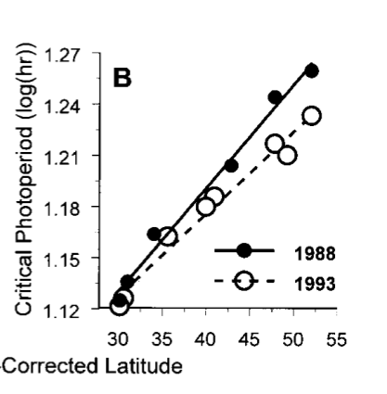
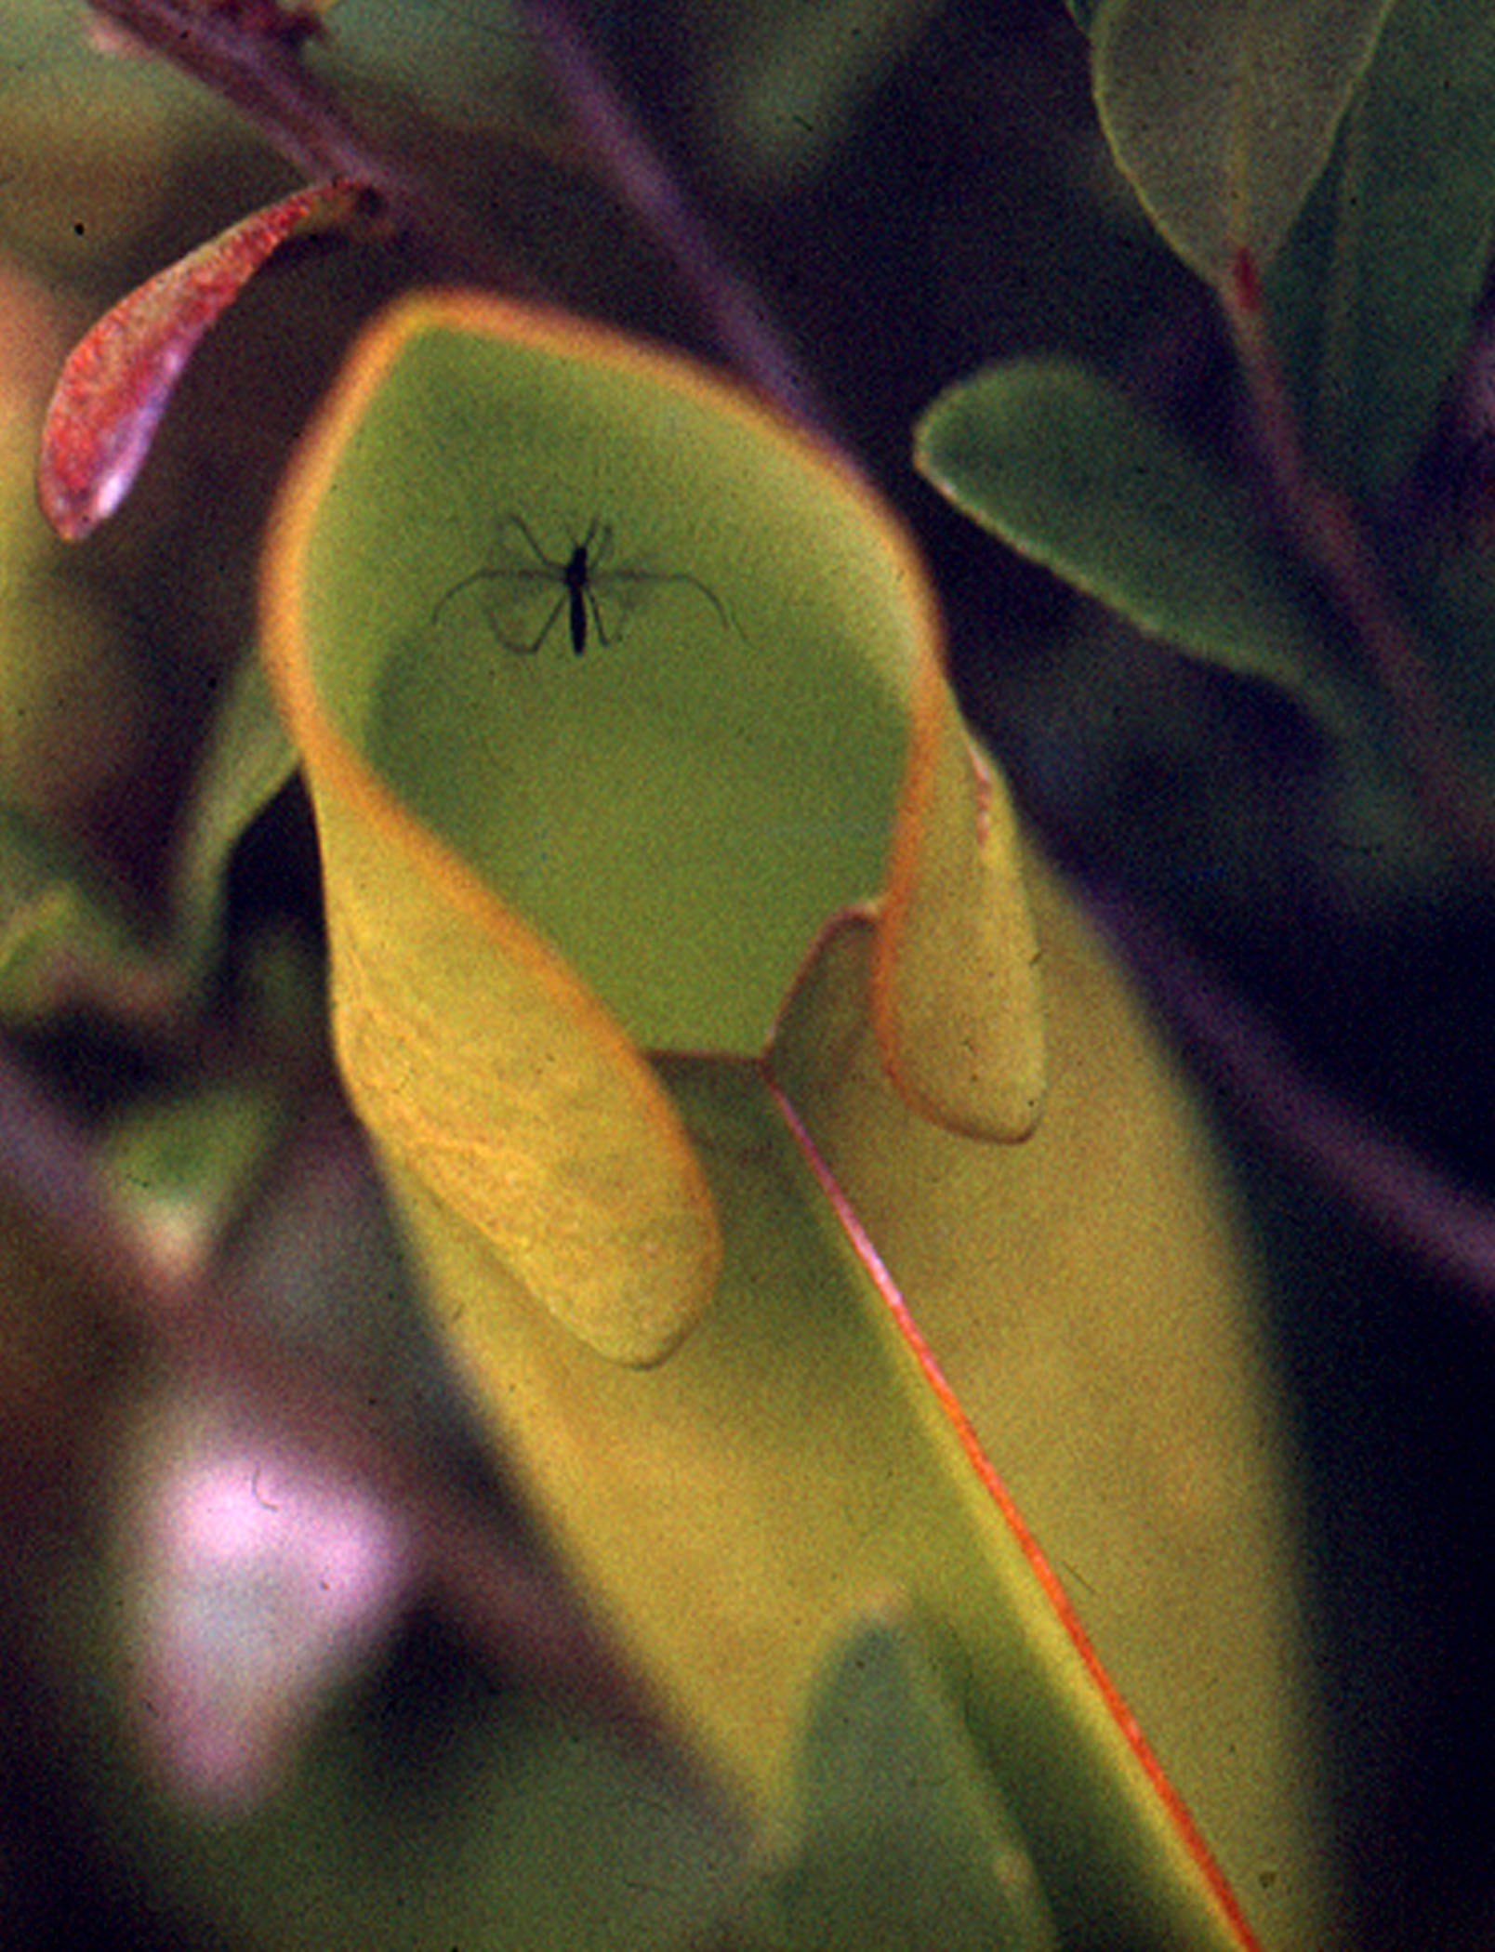
Has adaptation to climate change already occurred?
Very little evidence of this so far (largely a lack of proper tests)
Mosquito example: shifts toward shorter critical photoperiods (more southern phenotypes) increased with latitude as growing seasons lengthen
Pitcher-plant mosquito
Bradshaw & Holzapfel, PNAS 2001

Slide 20
So, how will climate change affect species?
Because the rate of change is so rapid, completely new assemblages of species (communities) will develop
But which species/lineages will survive?
Those that can evolve quickly
large populations, high fecundity
high genetic diversity within the populations
high heritability of traits
short generation times
Those that can migrate quickly
current large ranges
high mobility
easily dispersed seeds (long-distance dispersal)
Those with extremely plastic phenotypes

Slide 21
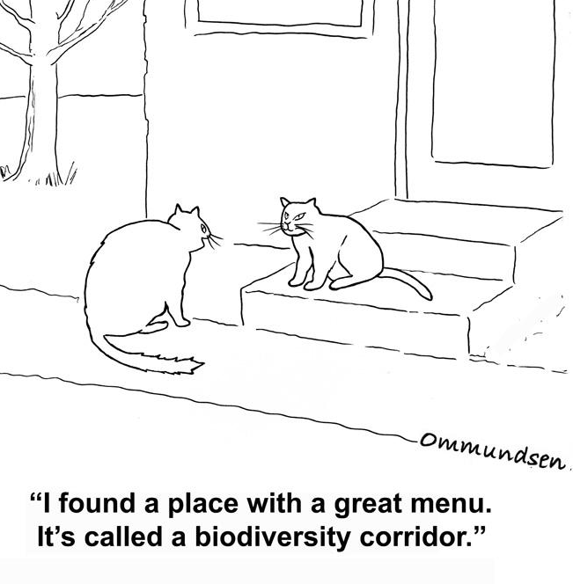
How do we use this information to minimize species extinctions as a result of climate change?
1. Conserve genetic diversity and capacity for adaptation
Conserve locally adapted populations (not just species)
Preserve large and heterogeneous habitats
2. Maintain dispersal/migratory abilities of organisms
Create connected network of habitat patches
Assisted migration?
3. Hit politicians over head with blunt object

Slide 22
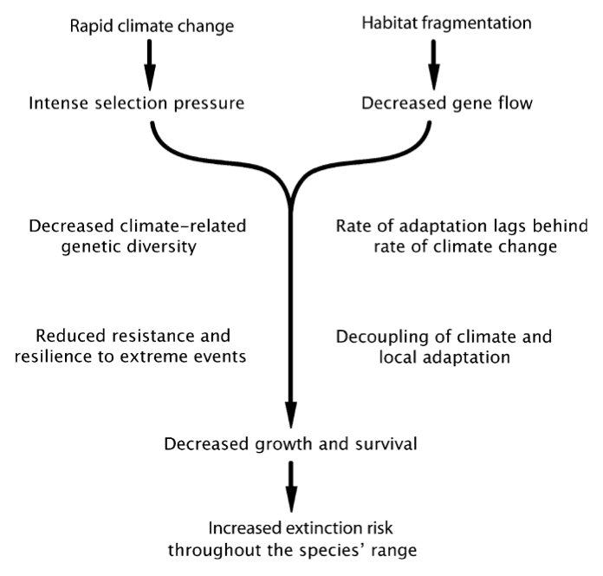
Climate change and the risk of extinction
Jump & Peñuelas 2005

Slide 23
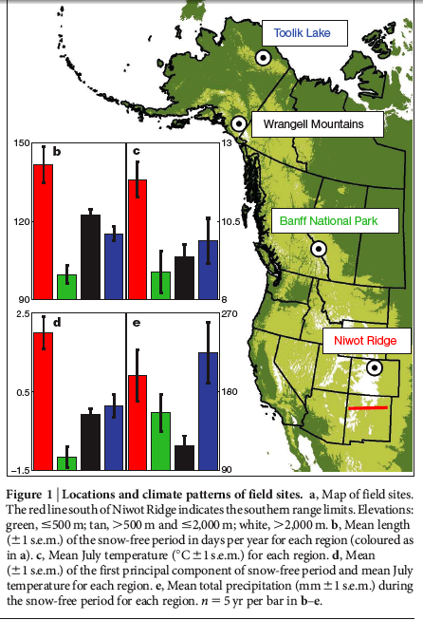
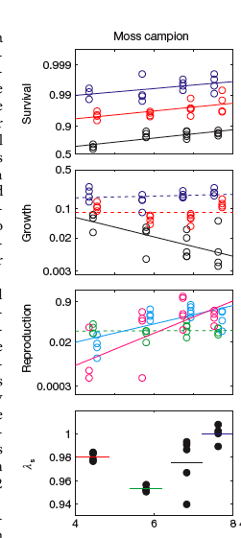
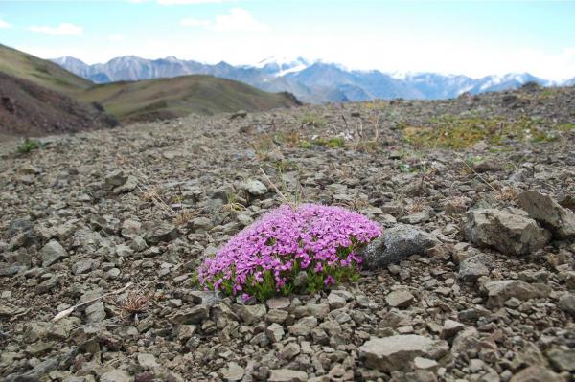
Local adaptation and phenotypic plasticity in an alpine plant
Silene acaulis
Morris and Doak 2010 Nature
Distance from equator
Differences in climate along a latitudinal gradient
High growth rates in young plants compensates for lower overall survival in southern populations
Poor performance across sites in warm years
Notes:
‹#›

Slide 24
Unanswered questions
Are many populations of plants already maladapted to their current environment?
What is the relative importance of migration, phenotypic plasticity and adaptation in responding to climate change?
What selection pressures are likely to be the main cause of extinction (temperature, drought, biotic, etc.)?

